Slide 1
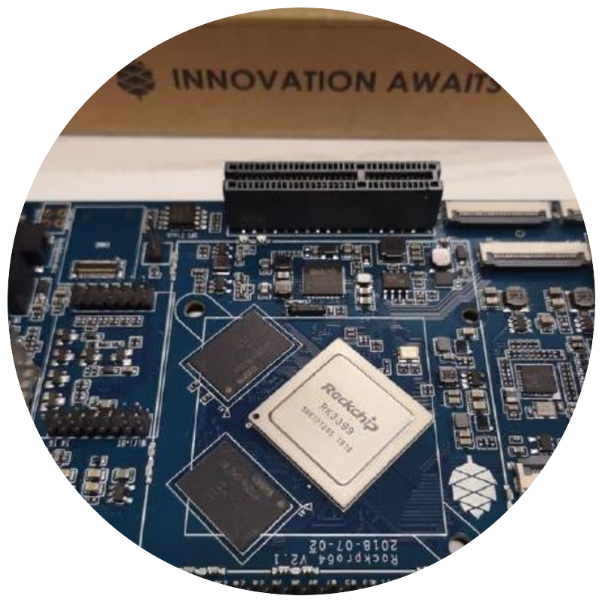
DIY Bitcoin
Ecosystem
Wallets, nodes, off-grid comms, miners, blockclocks, LN powered devices, etc.
t.me/DIYbitcoin

Slide 2
THE CYPHERPUNK ETHOS
“
Cypherpunks write code. We know that someone has to write software to defend privacy, and since we can’t get privacy unless we all do, we’re going to write it.
Eric Hughes, A Cypherpunk’s Manifesto, 9 March 1993
. . . and Cypherpunks build their own projects using off-the-shelf hardware.
02

Slide 3
MY STORY
I help devs and users
A wannabe dev that helps devs, users and projects.
I promote projects. Marketing and reach for DIY Bitcoin projects, the part builders rarely have time for.
I help devs get grants. Connecting builders like Odudex, qlrd and Tadeu with funding.
I help users learn. My DIYbitcoin Telegram is full of visuals, guides and useful info on DIY projects.
Join the chat t.me/DIYbitcoin
03

Slide 4
WHERE THE EFFORT GOES
The DIY Bitcoin ecosystem is broad, from wallets and nodes to miners and beyond. But most builder effort, and most users, land on one thing:
signers.
Why? Cheap and educational.
Signers are the cheapest hardware to get and play around with. Building one teaches you how wallets work, how they differ, and why they offer the options they do.
04

Slide 5
HOW WE GOT HERE
A short history of DIY signers
From early hacks and teaching tools to a whole family of reproducible signers.
Trezor hacks
Bowser Wallet
Specter-DIY
Krux
Kern
▸
BitBoy
DIY Jade
SeedSigner
ShieldSigner
05

Slide 6
WHY BUILD IT YOURSELF?
Security
01 / 03
Full transparency. Specter-DIY, SeedSigner, Krux and Jade are fully open source, so anyone can audit and verify what the device does, eliminating the black box risk of proprietary hardware.
Air gapped operation. Stateless signing via QR codes removes USB and wireless attack surfaces entirely.
Deterministic builds. Reproducible firmware ensures the running binary matches the public source code.
Hardware simplicity. Off the shelf components, no NDAs.
06

Slide 7
WHY BUILD IT YOURSELF?
Philosophical alignment
02 / 03
“Don’t trust, verify.” Extends Bitcoin’s core principle to your private keys, removing entire classes of manufacturer trust.
Personal sovereignty. Building and flashing your own device makes you self reliant and independent of vendors.
Censorship resistance. No firmware push, telemetry, or transaction blocking. Completely offline and untrackable.
07

Slide 8
WHY BUILD IT YOURSELF?
Practical benefits
03 / 03
Accessible and resilient. Built from off the shelf boards (STM32F469I-DISCO, Raspberry Pi Zero, ESP32-S3/P4, RISC-V kits) with chips from STMicroelectronics, Broadcom, Espressif and Canaan, giving global availability, vendor diversity and long term resilience.
Architectural diversity. Runs on ARM and Xtensa as well as open source RISC-V cores, with no dependence on any single architecture or manufacturer.
Low cost and educational. Ideal for learning PSBTs, descriptors, embedded systems and self custody fundamentals.
$8.99 to $200
$40 to $70
4
3
PER UNIT
MOST DEVICES
CHIP VENDORS
CPU ARCHITECTURES
08

Slide 9
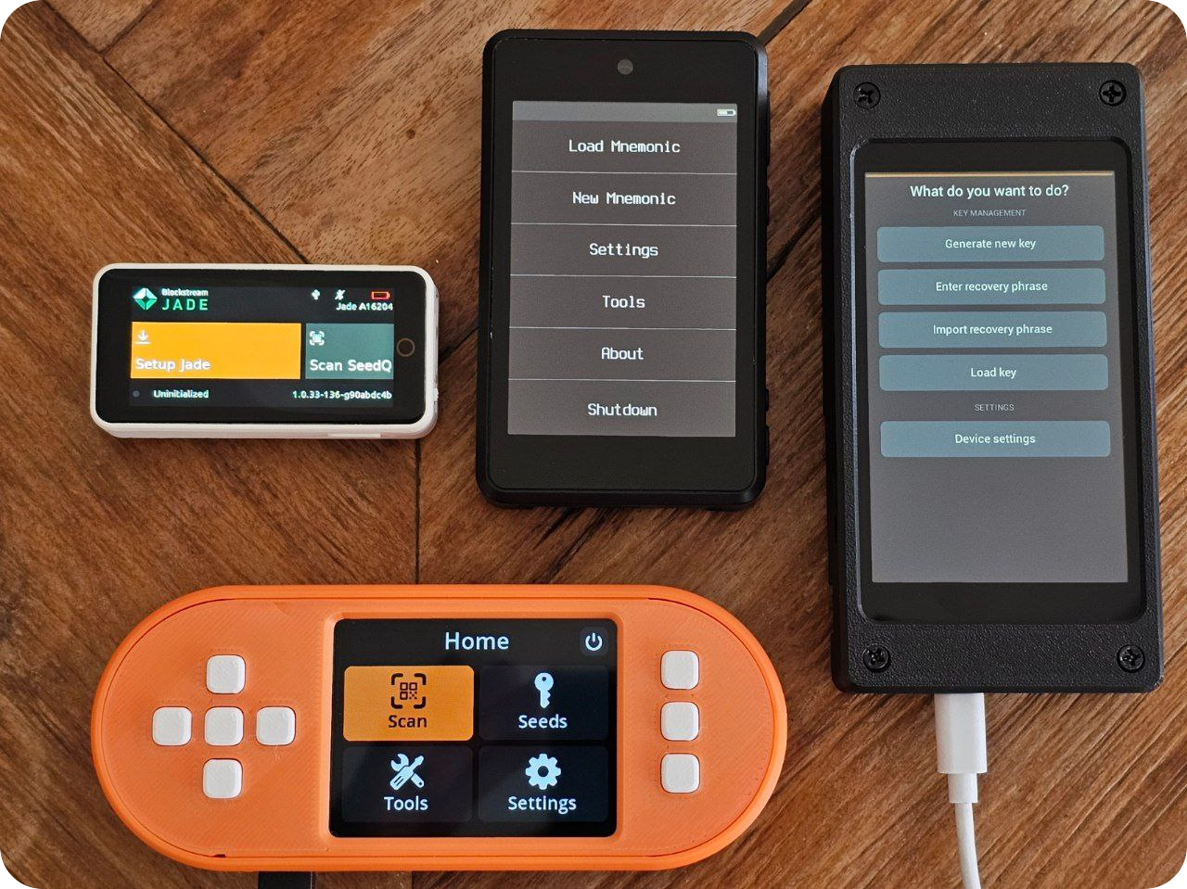
DIY HWW ECOSYSTEM IN 2025
Built on Embit
Embit, a modular Bitcoin library for Python and MicroPython.
HANDLES
keys
PSBTs
descriptors
scripts
serialization
Shared across Specter-DIY, SeedSigner and Krux.
The DIY HWW squad: Jade, SeedSigner, Specter-DIY and Krux
09

Slide 10
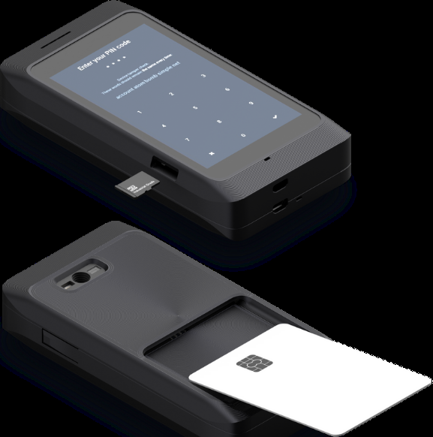
DIY HWW ECOSYSTEM IN 2025
Specter-DIY
The pioneer
STM32, built in C++ and MicroPython.
Multisig, Miniscript and Taproot.
Amnesic mode.
Key storage: plain text or encrypted, on microSD or SmartCard.
Secure bootloader with signed, reproducible firmware upgrades.
10

Slide 11
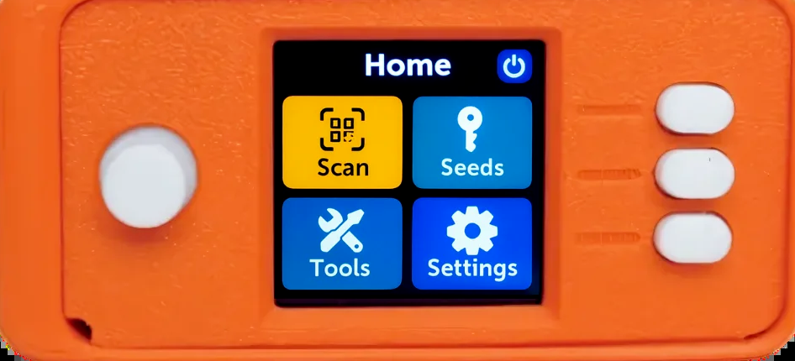
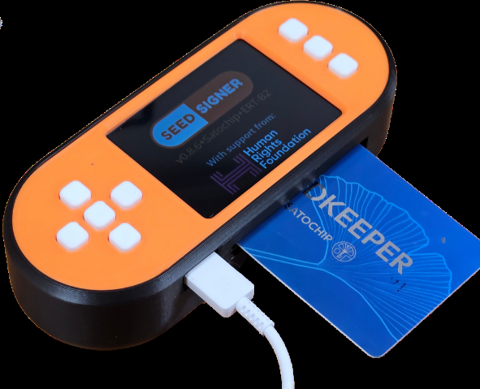
DIY HWW ECOSYSTEM IN 2025
SeedSigner
The UX champion
Stateless signer on Raspberry Pi Zero with camera.
Strong QR workflows.
Optional SmartCard support via CryptoGuide’s fork.
Ideal for air gapped signing and education.
11

Slide 12
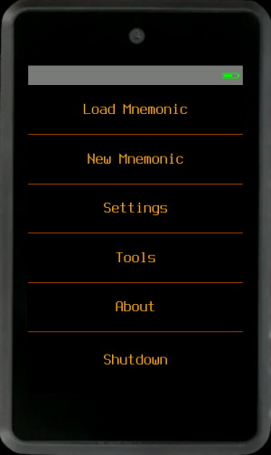
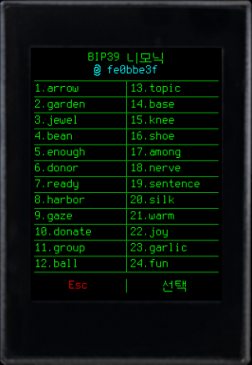
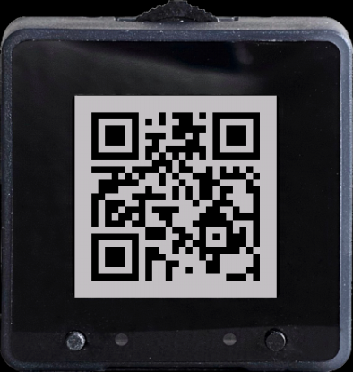

DIY HWW ECOSYSTEM IN 2025
Krux
The nerd
Kendryte K210 firmware. Open, fast and inexpensive.
Advanced QR handling with animated encode and decode.
Amnesic operation modes for secure signing.
Power user features for flexible backups and recovery.
12

Slide 13
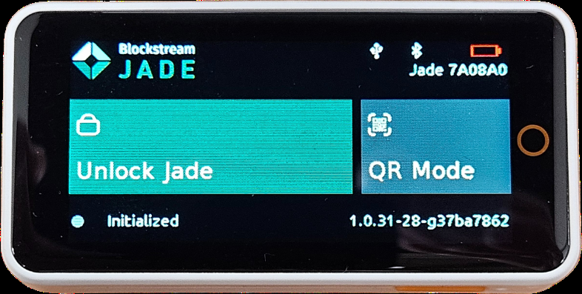
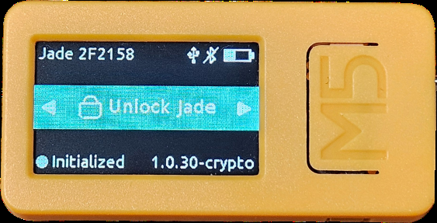
DIY HWW ECOSYSTEM IN 2025
Jade
The challenger
ESP32-S3 firmware.
Based on libwally.
Potentially the most affordable DIY HWW.
Amnesic operating mode.
13

Slide 14
THE KRUX STORY
An anonymous founder
Found on bitcointalk. I tracked down jreesun, the creator of Krux, on the forums. The founder is anonymous.
A door opened. jreesun let me promote Krux, then transferred GitHub ownership to Odudex and me.
A small, focused team. Roughly three devs near full time this past year: two on firmware, one on the installer. I handle marketing.
14

Slide 15
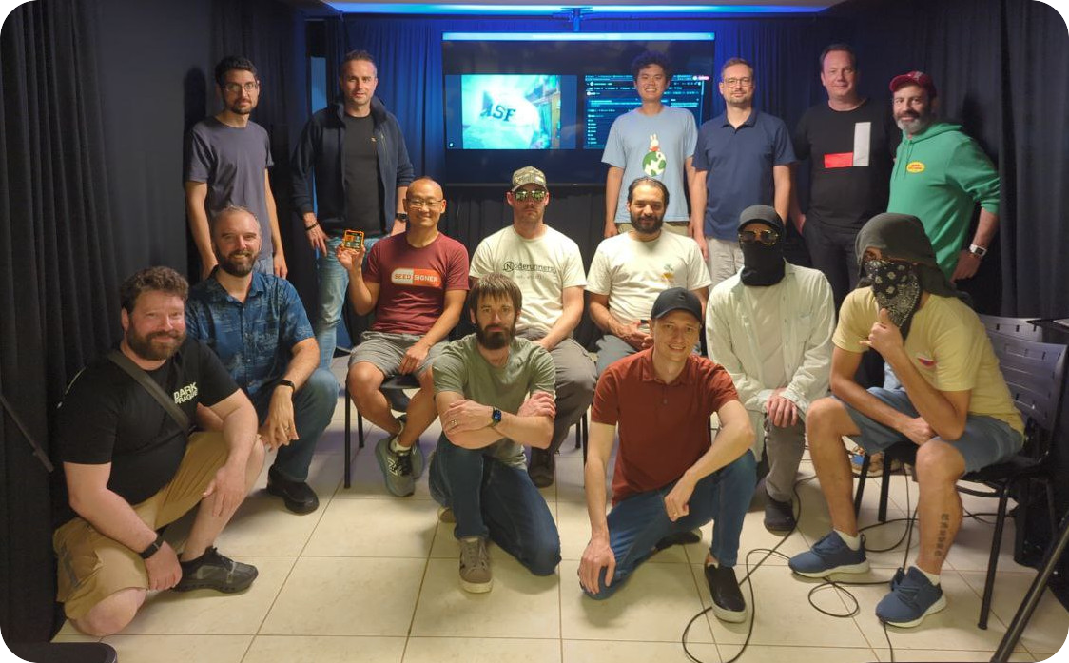
CASA21 RETREAT
São Paulo · Nov 2025
First in person retreat for the DIY HWW ecosystem, organized by Vinteum with support from HRF (special thanks to Lucas and Alex).
~20 contributors across every DIY HWW project; many met their teammates for the first time.
Not all participants wished to appear in the group photo.
15

Slide 16
CASA21 RETREAT
Goals & outcomes
GOALS
OUTCOMES
Knowledge transfer from Stepan Snigirev.
Define Embit’s roadmap and maintainer model.
Strengthen collaboration across projects.
Standardize workflows and foster community growth.
From personal tools to ecosystem. Built for specific threat models, open sourced for audit and reproducibility, now converging on shared libraries (Embit) and UX patterns.
Embit handed to shared maintainership, a maturation of the DIY hardware wallet ecosystem.
Knowledge exchange and alignment shaping future collaboration around shared standards and reproducible, open hardware.
16

Slide 17
CASA21 · TECHNICAL HIGHLIGHTS
What we dug into
01 / 02
Embit architecture
PSBT v2 & Miniscript
Modularization strategy and MicroPython constraints: memory usage, frozen modules, and reproducible .mpy builds.
Extending Embit for complex spending policies, Taproot fields, and consistent descriptor syntax across projects.
Secure bootloader
Testing & CI
Deep dive into Specter-DIY’s secure bootloader, exploring portability to other wallets.
Compared pipelines; proposed a shared Python and MicroPython test suite and reproducible environments.
17

Slide 18
CASA21 · TECHNICAL HIGHLIGHTS
What we dug into
02 / 02
UX & QR standards
Storage models
Compared BC-UR implementations, Krux’s animated QR module and Jade’s C decoder; aligned on patterns from SeedSigner’s design system.
Examined stateless, amnesic and encrypted storage approaches; reviewed entropy mixing and mnemonic generation.
Secure elements
Hardware & interop
Compared JavaCard, Tropic01 and Satochip; consensus to keep firmware SE agnostic but modular for optional use.
ESP32 and K210 optimization trade offs, Embit versioning, and a potential shared diy-hww-testing repository.
18

Slide 19
CASA21 · WHAT THE TEAMS AGREED
Consensus & collaboration
Rival projects came to the table and left aligned, turning parallel efforts into a shared roadmap.
Shared maintainership
Standardized workflows
Chip direction
Embit handed to a community maintainer model, so no single project owns the core library anymore.
Aligned on descriptor syntax, QR and BC-UR patterns and SeedSigner style UX conventions across devices.
Converged on Espressif’s ESP32-P4 as the platform for the next generation of signers.
SE agnostic firmware
Shared testing
Cross project trust
Consensus to keep firmware secure element agnostic but modular, with optional JavaCard, Tropic01 or Satochip support.
Proposed a common Python and MicroPython test suite and a diy-hww-testing repo for cross project validation.
The first in person meeting built the working relationships to keep collaborating after the retreat.
19

Slide 20
CASA21 · HARDWARE CONSENSUS
The next platform: ESP32-P4
The chip the teams agreed to build the next generation of signers on.
More power
Video off the CPU
Faster QR scans
The older S3 chip could not run the camera and MicroPython together. The P4 can.
Dedicated camera and screen circuits handle the video, so the main processor stays free.
Special hardware shrinks the camera image and reads the QR code. Slower clock than the K210, but quicker in real use.
Best chip for the job
Shared code
Boards ready now
Over a year of comparing options. The P4 came out the most powerful, the cheapest and the easiest to buy.
Open libraries written in C already run on SeedSigner. More signers will follow.
Several P4 dev boards already exist, with more on the way. Easy to start building today.
20

Slide 21
THE ROAD AHEAD
Where signers are heading
SECURE BOOT, YOUR CHOICE
Software secure boot
Hardware OTP secure boot
Reversible. You keep control and can reflash the device later.
Permanent. Burned into the chip, the Espressif standard.
Either way: secure boot, encrypted flash and RAM, and a PIN.
MIPI is the future
DIY is taking over
Dedicated camera and display interfaces are where signers are going. The P4 is first, more will follow.
Open, cheap and auditable. Proprietary signers, watch out.
21

Slide 22
GET INVOLVED
What’s next, and
how to join in
1
2
3
Build or buy
Explore the code
Join the movement
Get a DIY Bitcoin hardware wallet: Specter-DIY, SeedSigner, Krux or Jade.
Read, fork and contribute via the project GitHubs, reviewing issues, docs and pull requests.
Help improve reproducible builds, UX and interoperability, or organize local DIY workshops.
Don’t trust. Verify.
22

Slide 23
BEFORE YOU GO
Two invitations
1
2
Grants are within reach
Build a KISS signer with me
I helped myself get a grant at the retreat, once I saw how much DIY Bitcoin education is needed. Not a dev? New to it? You can get one too.
Calling any devs who want to collaborate. It is part of my hackathon presentation, right after this talk.
Find me github.com/kkdao · @diybitcoin · t.me/DIYbitcoin
23

